Slide 1
Immunize Kansas Coalition
3rd Quarter Meeting
August 9, 2019

Slide 2
Strategic Team Meetings
All IKC Members should participate in the strategic team discussion of their choice at this time.
Education & Awareness: Dan Leong
Grants & Funding: Carlie Houchen
Policy: Charlie Hunt
Improved Systems Performance: Sarah Good

Slide 3
Welcome and Introductions
Gretchen Homan, M.D., Chair

Slide 4
Coalition Updates and Business
Review and Approve 4/12/19 Meeting Minutes
Membership Updates and New Member Votes
Status of Funds Update – Denise Lantz
Nomination Committee – Carlie Houchen
Recognition of Outgoing Officers and Installation of New Officers

Slide 5
Recognition of Outgoing Officers and Installation of New Officers

Slide 6
Networking Lunch,
Followed by Sensemaking Workshop

Slide 7
Our Tomorrows Sensemaking Workshop

Slide 8
Community Sensemaking Workshop
Immunize KS Coalition
August 9, 2019
Notes:
Welcome to the XX Region Community sensemaking session.
As you know, Kansas received a federal planning grant to facilitate a collaborative effort to shape our state’s future direction for early childhood.
This one-year planning grant supports the development of a comprehensive needs assessment and strategic plan for early childhood in Kansas. The Kansas Children’s Cabinet and Trust Fund, Kansas Department for Children and Families, Kansas Department of Health and Environment, Kansas State Department of Education, and other early childhood stakeholders are partnering to carry out this important work.
One important component of the needs assessment work has been the collection of stories and perspectives from Kansas families to make sure that our research is reflective of what Kansans want for early childhood. That’s why we are here today. Before we get started, I’m going to run through the agenda and tell you what we will be doing today and how this work fits into the overall systems building efforts.

Slide 9
AGENDA
Introductions and Expectations
Working with Stories
Kansas Early Childhood Journey
Moving to Action
Sensemaking Guide
Next Steps
Notes:
This is your s4ensemaking session- we hav ethe regional demographics and the SAVVY dashboard to show you what you need.
The next 90 minutes are going to be action packed.
First, we will review what has happened over the last several months.
Next, we will discuss the community context an hear from the Organizational Partner who collected the stories.
Then we will look at who provided stories and the demographics of those individuals.
Next, we will present some themes and takeawyas from your region’s story bank. Then we will take a deep dive into the data and willSensemaking Analysis and Visualization (SAVVY) Dashboard.
After that, we will break up into groups and will explore the stories within patterns.
We will then move into action phase and begin to generate ideas to amplify the stories we want more of and to dampen those stories we want less of.
Finally, we will come back together and report out on our group findings and next steps.
Our Community Sensemaking Approach is growing and changing every time we return Our Tomorrows data to communities across Kansas.
Each session is unique to reflect the diversity of our State.

Slide 10
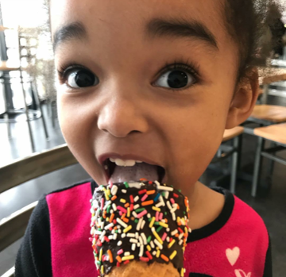
Who are you?
What do you want to learn from stories during the workshop today?
Notes:
Through this process, we have learned that giving and receiving stories is an intervention itself. The process is powerful. Individuals were told that they could give a very short status of their experience. That is not what the majority chose to do. Instead, they have taken the time to share an experience that means something to them.
Invite partner up to share their strategy and experience—
What worked
what would do differently next time
aspiration for the work.

Slide 11
Kansas Early Childhood Journey
50 Community Engagement Sessions
Online Survey
Our Tomorrows Story Collection
Review of Multiple Needs Assessments
Other Activities
Notes:
Whether it be on bi-weekly webinars, state meetings, community engagement sessions, or the early childhood journey website, you are probably aware that there has been a lot going on in early childhood in Kansas. Over the past few months, there have been over 50 community engagement sessions across the state; an online survey, and the Our Tomorrows story collection to collect input on what works and doesn’t work for Kansas children and families.
In addition to the public input, the Implementation Team has been reviewing needs assessments from several programs and collecting additional information about early childhood screenings, the workforce, and other topic areas.
Through these efforts, our goal is to assist communities like yours to make sure that families and children are supported from infancy through those early school years in ways that support healthy growth, development, and learning through high-quality early care and education environments. We thank you for your participation and efforts to collect the lived experience of individuals in your region. Today kicks off a conversation about the stories that were collected in your region and what they mean to you.

Slide 12
OUR TOMORROWS
Use SenseMaker® to collect 2,000* stories about thriving or surviving from families in Kansas​. *Minimum of 100 stories per community
Represent 100% of Kansas counties
Notes:
To capture parent voice and lived experience, we used SenseMaker to better understand family resilience in Kansas. The initiative is called Our Tomorrows because that’s really what our youngest citizens are. Our goals were ambitious—
To collect at least 2,000 stories from across Kansas
To have 100% representation of KS counties

Slide 13
OUR TOMORROWS
Gather to discuss and interpret stories in Community Sensemaking Workshops
Shape decisions collectively and identify solutions in Community Action Labs
Notes:
To share the stories and information back with the people who provided it through facilitated sensemaking. And finally,
To collectively identify actions that we can do today to get us closer to the world we want for Kansas children and families.
The purpose of the Our Tomorrows process is not to confirm what we already know. Rather, it is to understand problems in new ways and to explore a method that parallels what you do every day—try new things to support children and families. You are constantly adapting to better serve families. The SenseMaker process provides a method to document this path and to shine a light on what is working and what isn’t. If there are brightspots in your region, how can we lift them up to explore and start creating an evidence base for? And, how can we address the negative before they show up in the data set?

Slide 14
HOW IT FITS TOGETHER
EXPLORE STORIES about real-life struggles and resiliency
LIFT UP
Parent Voice and Parent Choice
PINPOINT NEEDS discover gaps, identify what’s working
USE the lived experience to inform the strategic plan
Notes:
On April 11th, Governor Kelly challenged us all to be early childhood stakeholders. Kansans have delivered and shared their thoughts through community engagement sessions and by sharing their lived experience through Our Tomorrows. The input will be incorporated into the needs assessment and will add a rich perspective to the population-based data. Specifically, the stories will be used to-–
Hear perspectives on real-life struggles and resilience through the story teller’s eyes
Understand how gaps are experienced
Lift up what families think and want
And finally, to use the input and the sensemaking to shape the strategic plan for KS.

Slide 15
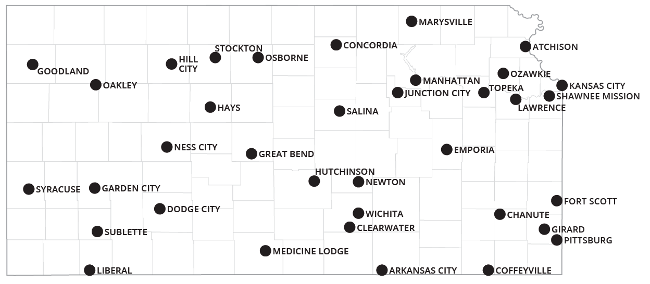
STORY COLLECTION IN KANSAS
Northwest
North Central
Northeast
Southwest
South Central
Southeast
1874 Stories Shared by Kansans, 2223 Total Stories Shared
Notes:
Here is a map of the stories that have been collected so far. If your county has a 0 by it, then we need your help!
Organisational partners for Our Tomorrows cover the counties shown with colored boundaries. Each partner organisation that collects at least 100 stories will be invited to participate in a Sense-Making workshop.
Orange dots show the planned location of the community engagement workshops.

Slide 16
Immunize Kansas Coalition
Notes:
Through this process, we have learned that giving and receiving stories is an intervention itself. The process is powerful. Individuals were told that they could give a very short status of their experience. That is not what the majority chose to do. Instead, they have taken the time to share an experience that means something to them.
Invite partner up to share their strategy and experience—
What worked
what would do differently next time
aspiration for the work.

Slide 17
SENSEMAKING GUIDE

Slide 18
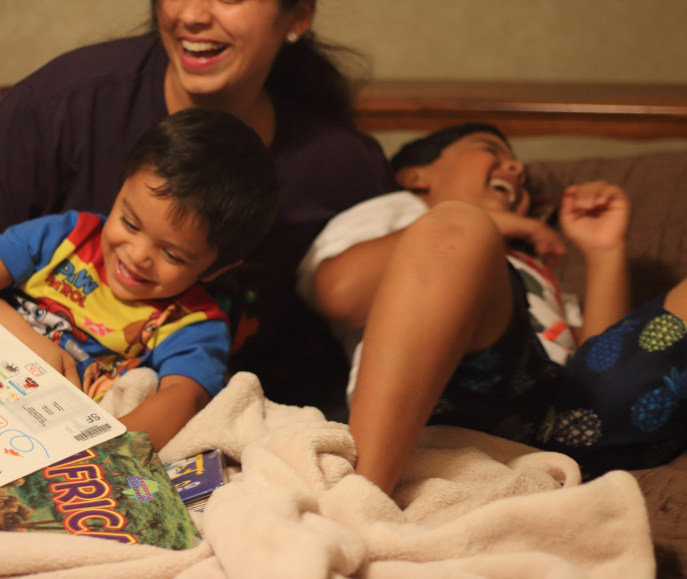
Working with Stories
Notes:
We are now going to explore the story bank through four different lens that align with the needs assessment—brightspots, disrupters, unheard voices, unmet needs. (give description of each one). During this next phase, ponder what you are hearing. Take note of what surprising. What you agree and disagree with. Are there any themes or patterns that we have missed.
Secondary Coding by the our tomorrows team
~1100 stories coded to date

Slide 19
Working with Stories
Read the stories in your story pack
Work with your partner/s to group similar stories together (by themes, categories, who is involved, etc)
Give each story group a title write on a sticky note.
Choose an example story that best represents group.
Notes:
Read the stories in your story pack
Work with your partner to group similar stories together (these might be themes, categories, who is involved, etc)
Give each story group a title write on a sticky note
Choose an exemplar story that best represents each story group

Slide 20
Working with Stories

Slide 21
Three Questions
What kinds of patterns did you notice in your stories?
What surprised you?
What did you expect to see, but didn’t?
Notes:
Read the stories in your story pack
Work with your partner to group similar stories together (these might be themes, categories, who is involved, etc)
Give each story group a title write on a sticky note
Choose an exemplar story that best represents each story group

Slide 22
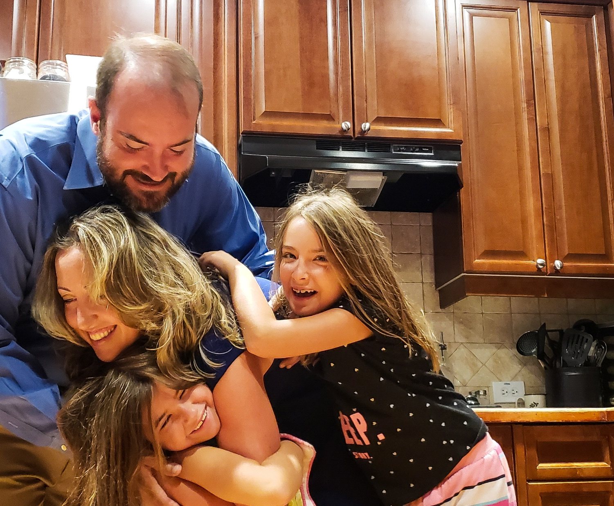
Moving to Action
Notes:
We are now going to explore the story bank through four different lens that align with the needs assessment—brightspots, disrupters, unheard voices, unput needs. (give description of each one). During this next phase, ponder what you are hearing. Take note of what surprising. What you agree and disagree with. Are there any themese or patterns that we have missed.
Secondary Coding by the our tomorrows team
~1100 stories coded to date

Slide 23
MOVING TO ACTION
Providing a monthly community lunch or hosting a pot luck
Adding a computer station for public use
Extending office hours once a week
Developing informational materials for new programs
Neighborhood playdates, visiting your neighbors

Slide 24
Notes:
Data, insight, action

Slide 25
Thank you
@CPPRMedia facebook.com/kucppr ourtomorrows.kucppr.org
Notes:
Refer to one pager and how to get involved.
Please help us improve our process by filling out a Hope-o-meter and Evaluation form

Slide 26
Kansas Immunization Program Report
Phil Griffin

Slide 27
Strategic Team Reports

Slide 28
Strategic Team Reports
Policy Strategic Team – Charlie Hunt
Education and Awareness Strategic Team – Dan Leong
Grants and Funding Strategic Team – Carlie Houchen
Improved Systems Performance Strategic Team – Sarah Good

Slide 29
Next Immunize Kansas Coalition Meeting
4th Quarter Meeting
November 8, 2019, Wichita

Slide 30
Closing
Susan Wood, IKC Chair

